Slide 1

AI and the Memory Wall: Overcoming Bandwidth Bottlenecks in Large Language Models
Submitted by:
Deepti Sahu 25071
Kaniki Bhikshapathi 24489
Puli Suhas Reddy 24123

Slide 2
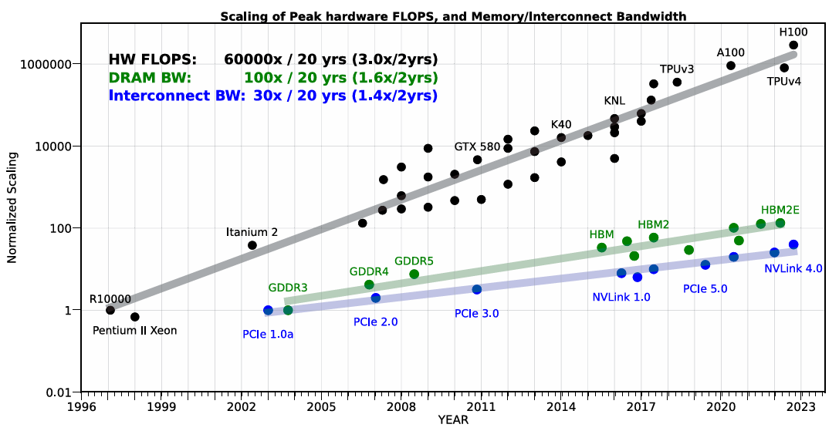
Surge in Large Language Models (LLMs):
Massive growth in model size and compute demands.
Training and inference of LLMs now require unprecedented computational resources.
Shifting Bottleneck:
Primary constraint is no longer just compute.
Memory bandwidth has become the dominant bottleneck.

Slide 3
The Memory Wall Problem
Compute vs. Memory Scaling
FLOPS scaling: 3× every 2 years
DRAM & interconnect bandwidth: Only 1.6× and 1.4× respectively
Result: Memory is now the primary bottleneck, especially for LLM inference
Limited Capacity and Bandwidth
The memory wall problem involves both the limited capacity and bandwidth of memory transfer at various levels: on-chip, between compute logic and DRAM, and across different processors.
The capacity and speed of data transfer have significantly lagged behind hardware computing capabilities.

Slide 4
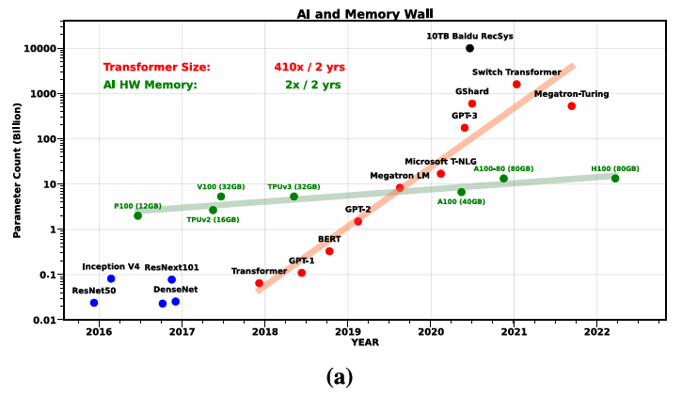
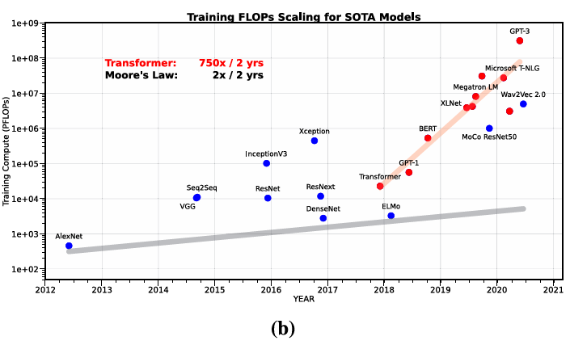
Shows exponential growth in model parameters over years (red circles).
Transformer model sizes have increased by 410× every two years
Green dots show GPU memory has only doubled every two years → cannot keep up with model size.
Key Insight: Memory capacity is lagging behind model parameter growth → creates bottlenecks in single-device training.
The total compute (in PetaFLOPs) required to train various state-of-the-art models (CV, NLP, speech).
Compute demand has been increasing at 750× every two years. Highlights compute-intensive nature of modern LLMs and vision models
Key Insight: Compute demands alone are misleading—memory access and communication matter more for performance.

Slide 5
Summarizing: Scaling Trends in AI Models
Exponential Growth of LLMs
Compute vs. Memory Capacity
Motivated by neural scaling laws, practitioners have been scaling the amount of data, model size, and compute needed to train recent models at unprecedented levels.
The compute/FLOPS needed to train recent models has increased by a factor of 750 per two years (2018–2022), while LLM sizes have scaled at a rate of 410 per two years.
Communication Bottlenecks
Distributing work over multiple processes faces the memory wall problem due to the communication bottleneck of moving data between neural network (NN) accelerators.

Slide 6
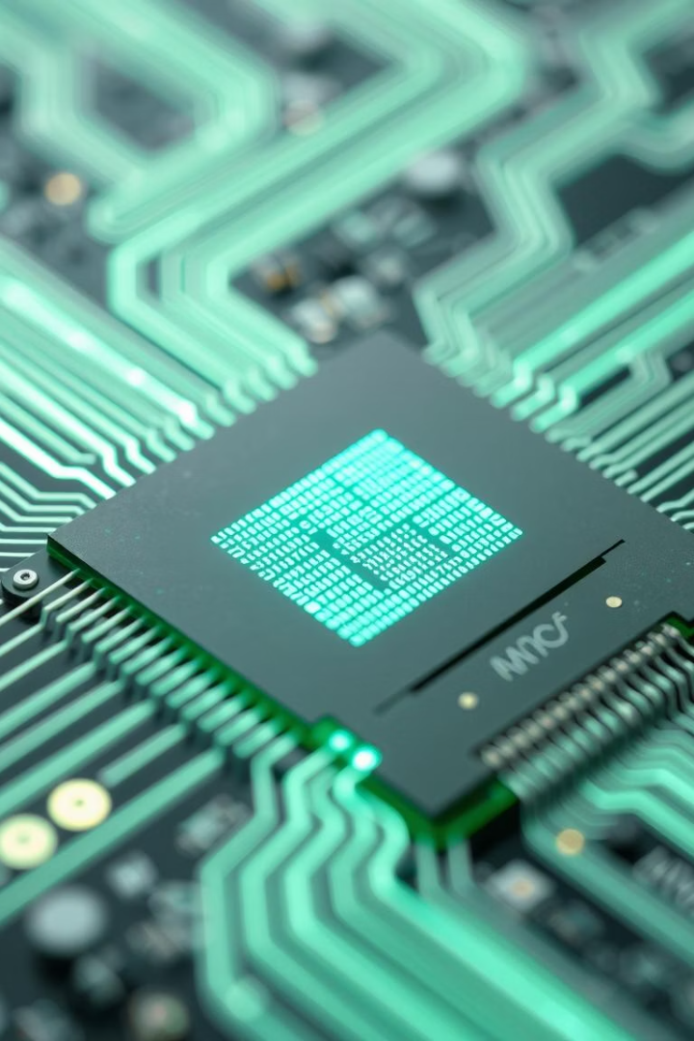
Intrachip Memory Bottlenecks
Memory Transfers
Specialized Compute Units
Even when a model fits within a single chip, intrachip memory transfers from/to registers, Level 2 cache, and global memory are increasingly becoming the bottleneck.
Advancements in specialized compute units, such as tensor cores, allow arithmetic operations to finish in a few cycles, requiring rapid data feeding to keep these units utilized.
Disparity in Scaling
Peak server hardware FLOPS have been scaling faster than DRAM and interconnect bandwidth, making memory a bottleneck even for single-chip models.

Slide 7
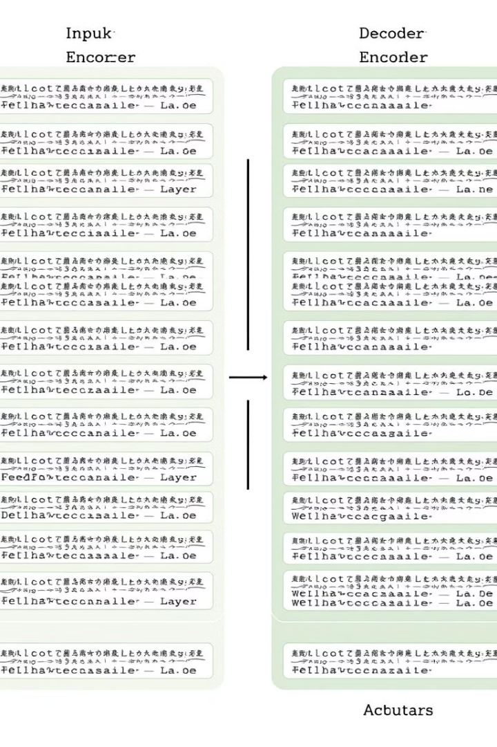




Case Study: Transformer Inference
Encoder Architecture
Processes all tokens concurrently (e.g., BERT).
Decoder Architecture
Runs autoregressively to process and generate one token at each iteration (e.g., GPT).
Arithmetic Intensity
Measures Performance Bottleneck: the number of floating-point operations performed per byte loaded from memory.

Slide 8




Arithmetic Intensity and Performance
Arithmetic Intensity
BERT vs. GPT-2
Impact on Latency
Computed as the number of FLOPs divided by the number of MOPs (memory operations).
BERT-Base and BERT-Large (encoder models) involve matrix–matrix operations, while GPT-2 (decoder model) involves repeated matrix–vector multiplications.
GPT-2 has higher MOPs and lower arithmetic intensity, resulting in significantly longer latency despite similar FLOPs compared to BERT.
A model with higher arithmetic intensity can run faster with the same or more FLOPs than a model with lower arithmetic intensity, showcasing the memory wall's impact on decoder models.

Slide 9
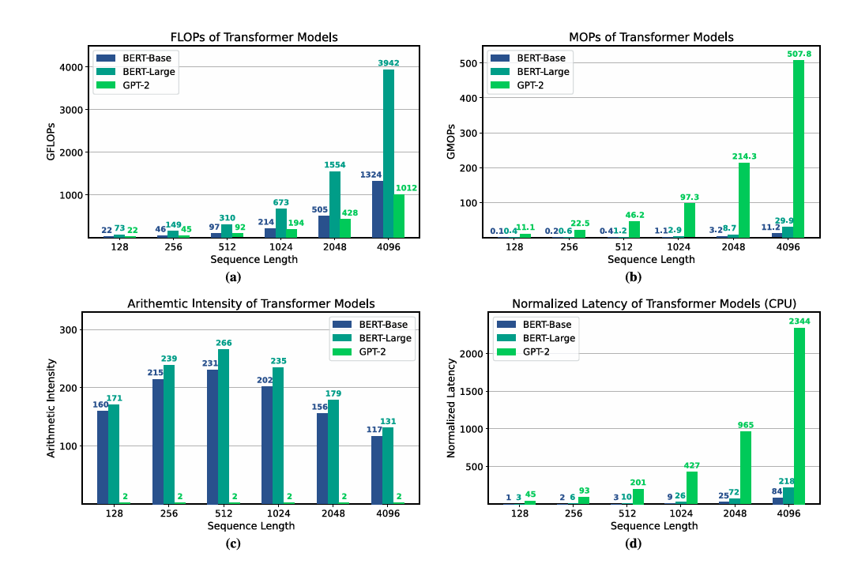

Profiling Transformer Workloads
Profiling results for BERT-Base, BERT-Large, and GPT-2 models show that GPT-2 latency is significantly longer due to higher MOPs and lower arithmetic intensity. This highlights the memory wall's impact on decoder models.

Slide 10
Promising Solutions:

Slide 11
Promising Solutions:
I. Efficient Training Algorithm:
Second-Order Optimization
1
More robust to hyperparameter tuning but with higher memory footprint.
Activation Checkpointing
2
Reduces memory footprint by recomputing activations when needed.
Low-Precision Training
3
Designing algorithms robust to low-precision arithmetic (e.g., use of half-precision (FP16)).

Slide 12




II. Efficient Deployment Strategies
Quantization
Pruning
1
Reduces model precision for inference (e.g., down to INT4).
Removes redundant parameters in the model.
2
Unstructured Sparsity
4
Structured Sparsity
Prunes up to 80% of neurons with minimal impact on accuracy.
3
Prunes up to 30% of neurons with minimal impact on accuracy.

Slide 13



III. Rethinking AI Accelerator Design
1
Compute/Bandwidth Tradeoffs
2
Optimized Cache Hierarchy
3
Higher Capacity DRAM
Sacrifice peak compute to achieve better compute/bandwidth tradeoffs, incorporating a well-optimized cache hierarchy and higher capacity DRAM. This can mitigate distributed-memory communication bottlenecks and improve performance for bandwidth-bound problems.

Slide 14
Conclusion:
AI is approaching a scaling ceiling not due to compute—but due to memory & data movement limits.
Solving the memory wall requires joint innovation in:
Model design
Training algorithms
Hardware architecture
Future of AI hinges on our ability to optimize both compute and memory together.

Slide 15
Thank You

